Slide 1
How to Look Before You Leap
Clark Glymour
cg09@andrew.cmu.edu

Slide 2
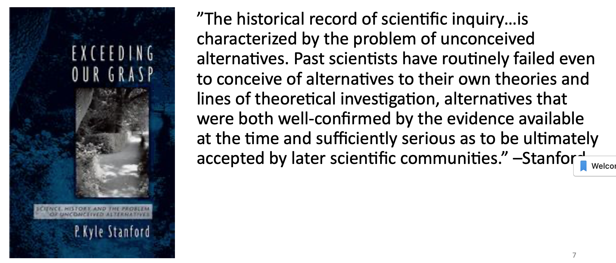
Look Before You Leap to Causal Conclusions
“But it is not, I conceive, a valid reason for accepting any given hypothesis, that we are unable to imagine any other which will account for the facts. There is no necessity for supposing that the true explanation must be one which, with only our present experience, we could imagine”. --J.S. Mill, A System of Logic
“If nothing else, our own experience suggests that however many different specifications we think of, there are always others which had not occurred to us.”
--Gelman and Shlizi, 2011

Slide 3
But How Can Scientists Consider Alternative Explanations They Have Not Thought Of?
Long literature in the social sciences on “model building”
Much of it is vague heuristics or evades the question in the title.
(examples: Cowles Commission; Herman Wold, Theoretical Empiricism: A General Rationale for Theoretical Model Building, 1985.)
Arthur Goldberg: let the data be your guide.

Slide 4
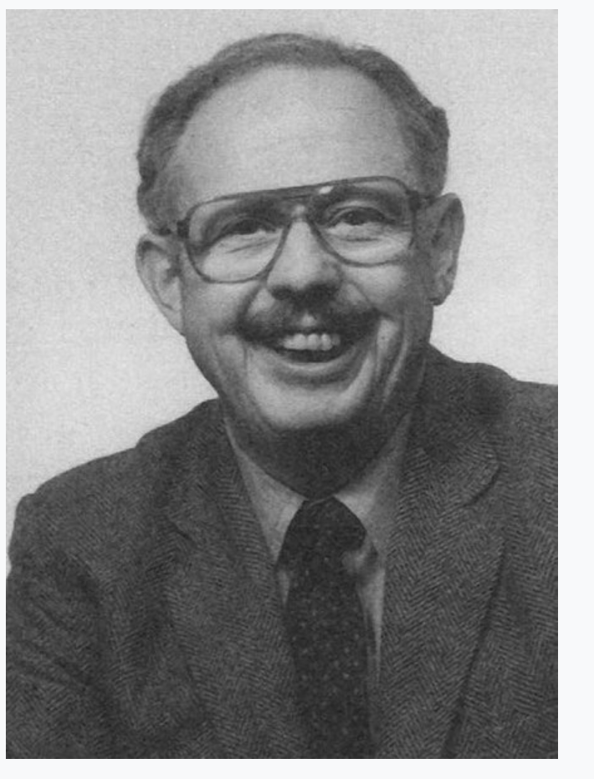
Searching for a Causal Model: An Example
Arthur Goldberg, 1966
Ok, he didn’t win a Nobel, but his collaborator
Lawrence Klein did, and he wrote the (ok, a)
book on econometrics.

Slide 5
Discerning a Causal Pattern among Data on Voting Behavior, The American Political Science Review , Vol. 60, No. 4 (Dec., 1966), pp. 913-922
“Since it is the case that causal impacts should appear as non-zero value regression coefficients, causal models in which any of the variables con- tribute directly to less than the full set of sub- sequent variables have implied zero value regression coefficients. Hubert Blalock points out that such regression coefficients imply zero value correlation coefficients. It thus becomes possible with the aid of partial correlation coefficients to make an empirically based decision among alternate causal models purporting to describe the causal relationships within the same set of variables. This is the technique which will be used in the present analysis.”
E.g. If r_{XZ} ≠ 0 and r_{XZ .Y} = 0 then infer Y is causally between X and Z

Slide 6
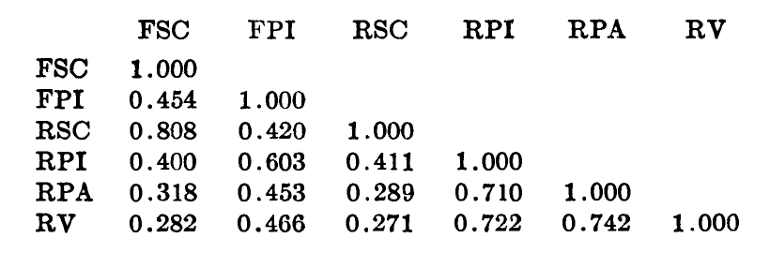
Goldberg’s Data
Variables:
father’s sociological characteristics (FSC);
father’s party identification (FPI);
respondent’s sociological characteristics (RSC);
respondent’s party identification (RPI
respondent’s partisan attitudes (RPA)
respondent’s vote (RV ) for U. S. President in 1956 (Eisenhower vs. Stevenson).
Goldberg assumes variables later in this list are not causes of previous variables, and linearity
Correlations
N = 645

Slide 7
Goldberg’s Search Spaces
Goldberg calculates the number of possible adjacencies in the graph and says:
“Given the assumption of a unidirectional causal ordering, there are fifteen possible causal arrows in a six variable model.”
…….
But there are two possible directions for each adjacency.
There are 3,781,503 directed acyclic graphs on six vertices.
Assuming that RV is not a cause of any of the other variables, there are 936,992 acyclic graphs.
Assuming Goldberg’s list ordering there are 16,384 directed acyclic graphs.
How can Goldberg consider all of these? He cannot, and he does not.

Slide 8
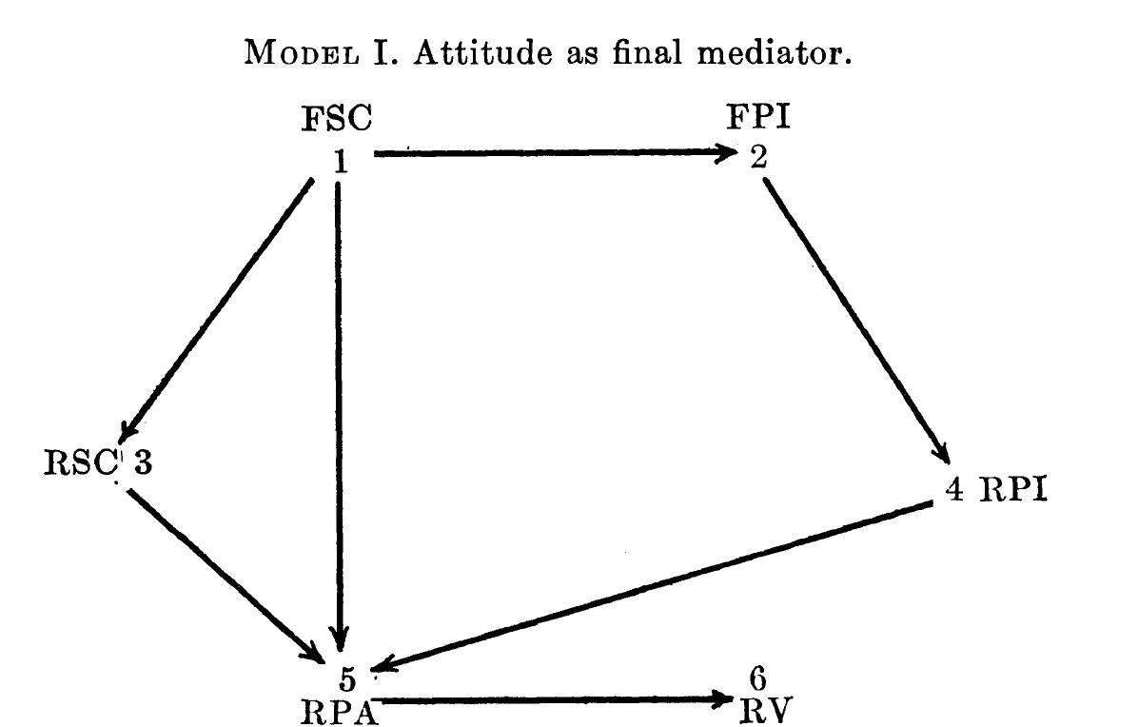
Goldberg’s Search: Model 1

Slide 9
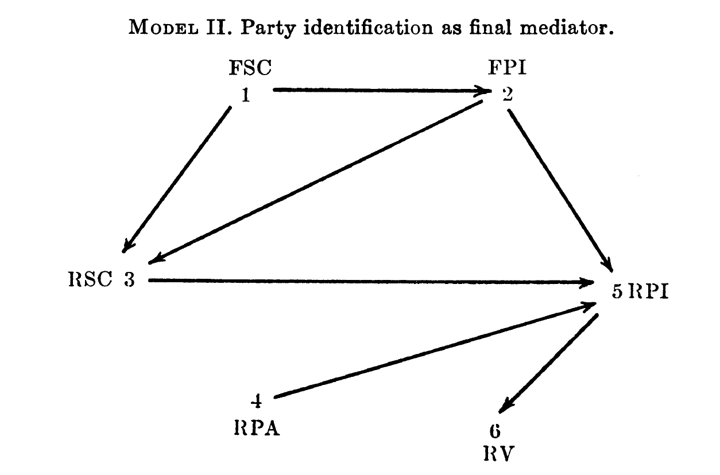
Goldberg’s Search: Model II
Goldberg:
”In Model II party identification is taken as the final arbiter. Three arrows have been dropped: those linking FSC and RPA, RSC and RPA, and RPA and RV. The first two were dropped in a search for parsimony, and the third was dropped to implement the central idea of this particular model. Finally the lessons of Model I have been incorporated in Model II pre- sented in Fig. 2. Note that in Model II the time sequence between RPI and RPA is the reverse of what it was in Model I. ”

Slide 10
Goldberg’s Search, Model III
“[the] poor fit [of Model II]with the data and suggests that to the extent that unidirectionality is assumed and parsimony desired, the RPI ought to be re-garded as prior to RPA. Support is thus lent to the positions of Lane and Sears, Greenstein, and others who have urged the importance of the early socialization of political symbols.

Slide 11
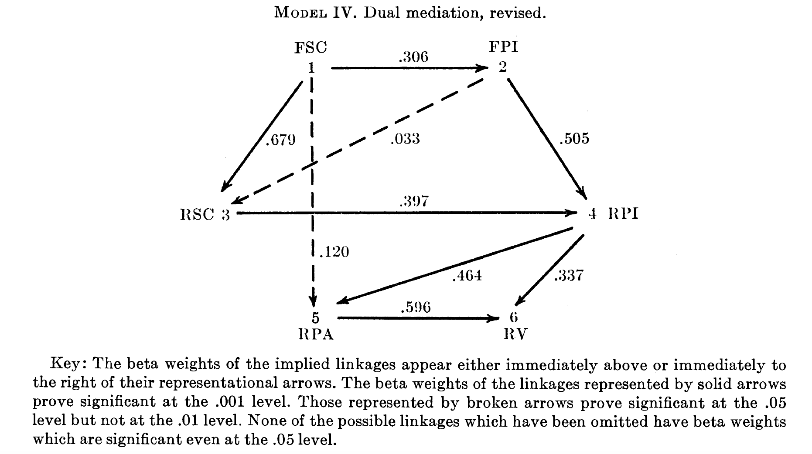
Goldberg’s Search: Model IV

Slide 12
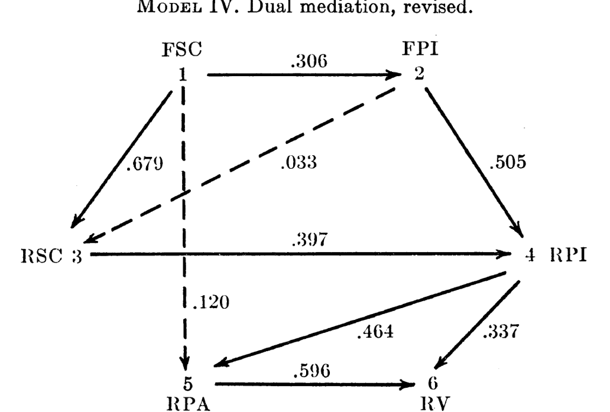
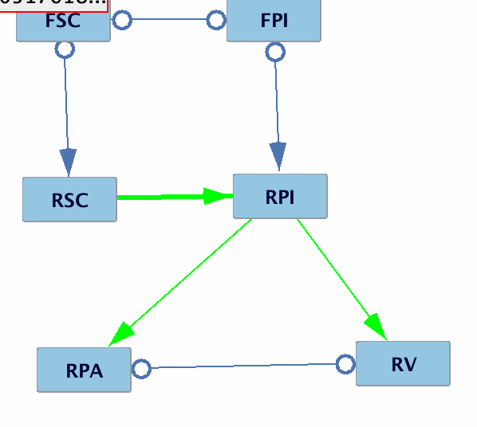
What a modern automatic causal search algorithm finds with this data—without Goldberg’s prior assumptions about causal order.
GraspFCI Search Result
0-0 indicates arrowhead marks not estimated

Slide 13
Some Questions and Answers
How long did the computer search take?
  About 1 second
Did the search require any prior knowledge about the graphical causal structure?
  Only acyclicity.
Does the search estimate coefficients?
  No, but given the model and Goldberg’s Normal distribution assumption, that is trivial to do.
Does the search have a standard error?
  Coefficient estimated using the model have standard errors, but unless you have the right causal model, standard errors are meaningless.
Does the search look at more models than Goldberg did?
  Implicitly, yes; explicitly, no.
Is the model true?
  The only truth guarantee is that if the distribution family is correct, the search procedure is a consistent estimator in the statistical sense—i.e. it converges to true information in the large sample limit.
Are there other ”consistent algorithms” that would do the search?
  Yep, I just picked a recently well-studied one.
Would other ”consistent” search algorithms give the same result?
  Haven’t tried. Maybe, maybe not. If not, they would give another reason to look before you leap.

Slide 14
”Latent” Common Causes?
Goldberg:
“When the limit of a theory is encountered, in the form of the occurrence of a theoretically precluded phenomenon, the search is begun for some component of the error term which is correlated in the relevant sense, and in conjunction with its discovery, the substance of the theory is revised.”
Obscure way to say that one should search for “latent variable” models of the data with unmeasured common causes.
But Goldberg doesn’t do it. Let’s.

Slide 15
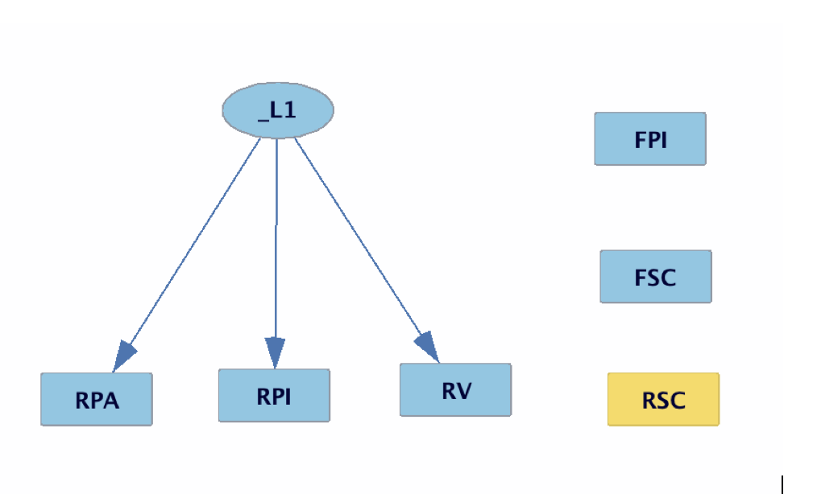
Build Pure Clusters
A ”consistent” algorithm for searching for subsets of measured variables that share a single common cause and that have no direct causal connections with one another.
FPI, FSC and RSC are ignored because the search cannot find a single common cause model that includes them.

Slide 16
The Unknown, Unused Literature
Developments in consistent computerized search for causal explanations in the last 30 years from hundreds of researchers:
  Equilibrium structural equation models
  Variable selection for experiments
  Time series, stationary and non-stationary
  Multiple data sets
  Mixed data sets from different causal structures
  Discrete and continuous variables
  Causal relations among unknown, unmeasured common causes
  Cyclic equilibrium models (simultaneous equation models.)
Glymour, C., Zhang, K., & Spirtes, P. (2019). Review of causal discovery methods based on graphical models. Frontiers in genetics, 10, 524.
For software: https://www.ccd.pitt.edu/tools/

Slide 17
What’s the Use?
The reported non-replicability of experimental and non-experimental results in the social and biological sciences might be ameliorated if, before leaping to a model, scientists looked and confirmed their hypotheses with search methods or reported alternatives that explain their data as well.
Lots of things may be measured but relatively few will be subjected to experiment. Computerized search can narrow down the relevant variables (and potential confounders) with the use of ancillary observational data. For a dramatic example with a sample of 47 for ancillary data to find variables for experimentation from among 20,000 potential causes, see
Stekhoven, D. J., Moraes, I., Sveinbjörnsson, G., Hennig, L., Maathuis, M. H., & Bühlmann, P. (2012). Causal stability ranking. Bioinformatics, 28(21), 2819-2823.

Slide 18
Why Are These Methods “Unknown” and Little Used?
Taboos against computerized search;
Not part of standard undergraduate or graduate statistical education—no textbooks;
Most algorithms published in computer science conferences and journals;
Algorithms require some computational skill and theoretical understanding to use or use intelligently;
Strong editorial and reviewer bias against manuscripts based on automated search;
Many methods, some of them good (i.e., consistency proofs and extensive simulation tests), many of them not so good.

Slide 19
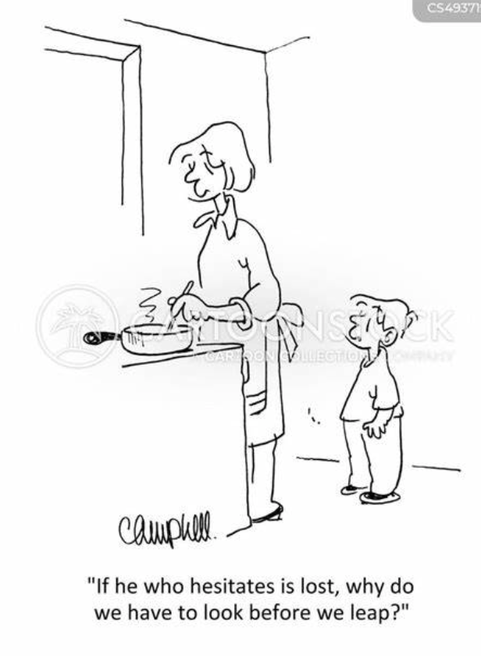

Slide 20
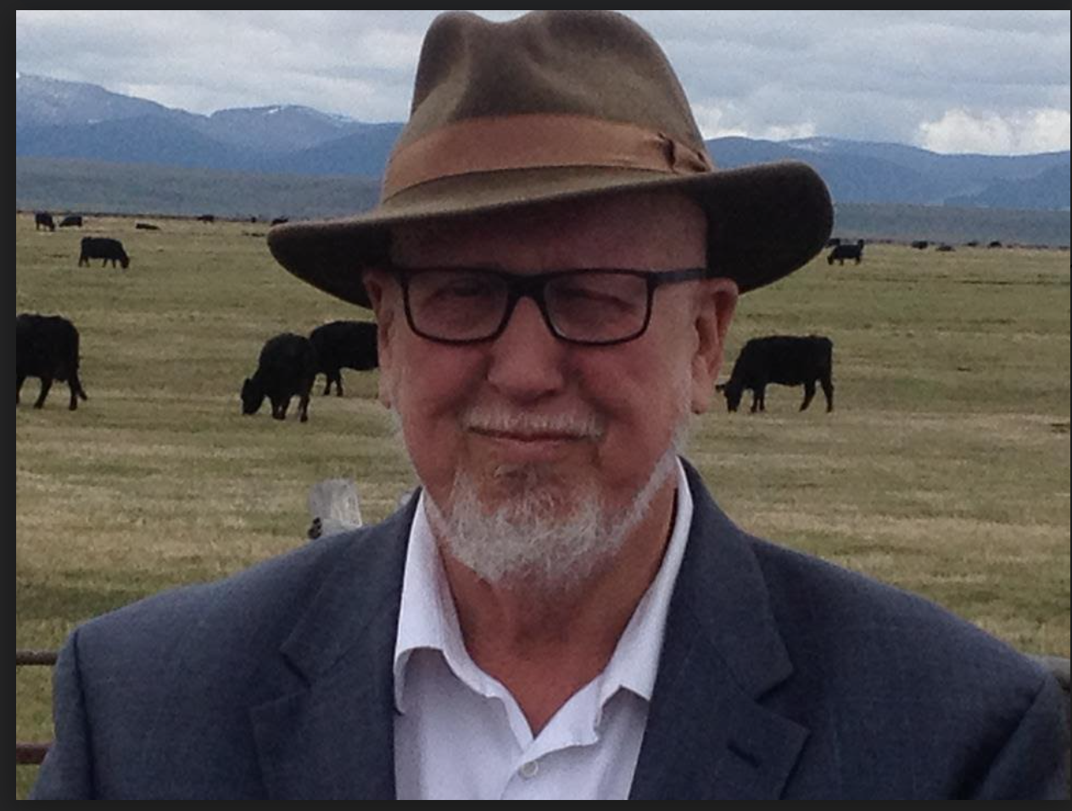
That’s All Folks!

